Slide 1
UNCAT AND
THE DEFINITION
OF TORTURE

Slide 2
PURPOSE OF UNCAT
“
make more effective the struggle against torture and other cruel, inhuman or degrading treatment or punishment throughout the world
Underlying Principle:
Absolute prohibition
of torture
“
Notes:
© Thinkstock.

Slide 3
DEFINITION
“
any act by which severe pain or suffering, whether physical or mental, is intentionally inflicted on a person for such purposes as obtaining from him or a third person information or a confession, punishing him for an act he or a third person has committed or is suspected of having committed, or intimidating or coercing him or a third person, or for any reason based on discrimination of any kind, when such pain or suffering is inflicted by or at the instigation of or with the consent or acquiescence of a public official or other person acting in an official capacity. It does not include pain or suffering arising only from, inherent in or incidental to lawful sanctions.
“
Notes:
© Thinkstock.

Slide 4
Notes:
This is an animated video produced by REDRESS on the Convention against Torture and Other Cruel, Inhuman or Degrading Treatment or Punishment (UNCAT).
The Convention is an international human rights treaty, under the review of the United Nations, guiding States on how to prevent and respond to torture and other ill-treatment.
This short video explains what UNCAT is about, which are the esssential elements of the definition of torture, and the key obligations of states under the Convention.

Slide 5
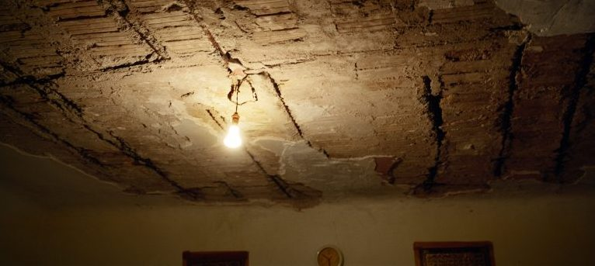
ELEMENTS
Conduct inflicting severe pain or suffering
Intent
Specific purpose
Involvement of a public official
Notes:
© Jim Goldberg, Magnum Pictures.

Slide 6
ELEMENTS: CONDUCT
Act or omission
IAComHR, SL v. Venezuela
Prisoner denied medicine
Physical or
mental harm
CAT, Colmenarez v. Venezuela
Enforced disappearances
Powerlessness
Dependency
Custody
Notes:
Photo of Ibrahim Al Obeidi (left) and his brother Fathallah holding a picture of their murdered brother Salem in the living room of the family home (© Ivor Prickett/Panos Pictures).

Slide 7
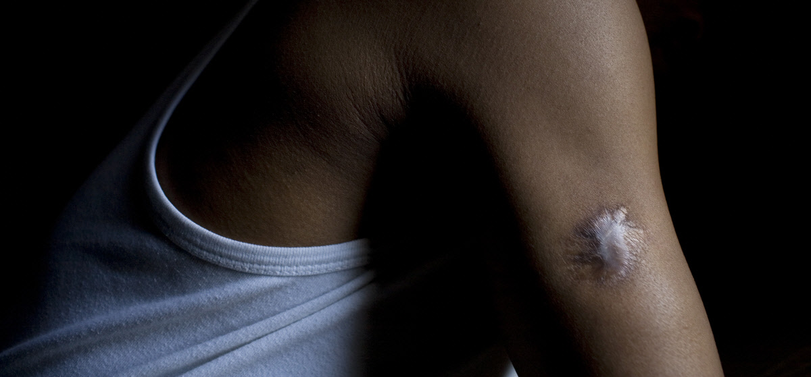
ELEMENTS: INTENT AND PURPOSE
Intention to inflict pain
Force a confession
Discriminate
Punish
Humiliate
Coerce
Etc
Purpose
Notes:
Photo of Boni. Boni had been a businessman in Kinshasa, DR Congo, but was arrested and detained on suspicion of opposing the ruling government. While in detention he was forced into an electric chair, was repeatedly beaten and had a knife plunged through his armpit. He was also stabbed from his chest to his groin and his torture scars remain clearly visible (© Abbie-Trayler-Smith/Panos Pictures).

Slide 8
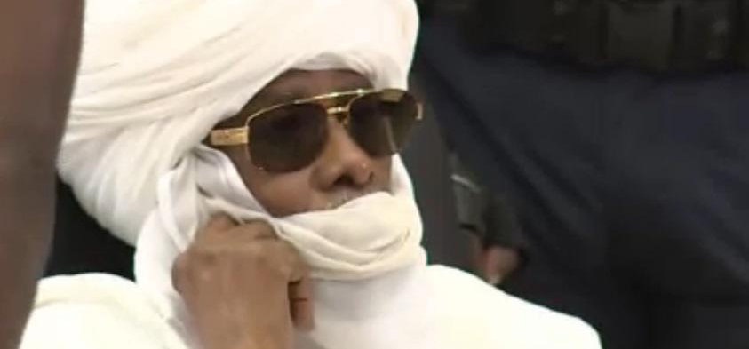
ELEMENTS: INVOLVEMENT OF PUBLIC OFFICIAL
State official
Official capacity
Non-state actors
Notes:
Photo of the former Chadian dictator Hissène Habré. On May 30, 2016 Habré was convicted of crimes against humanity, war crimes, and torture, including sexual violence and rape, by the Extraordinary African Chambers in the Senegalese court system and sentenced to life in prison(©Radiodiffusion Télévision Sénégalais).

Slide 9
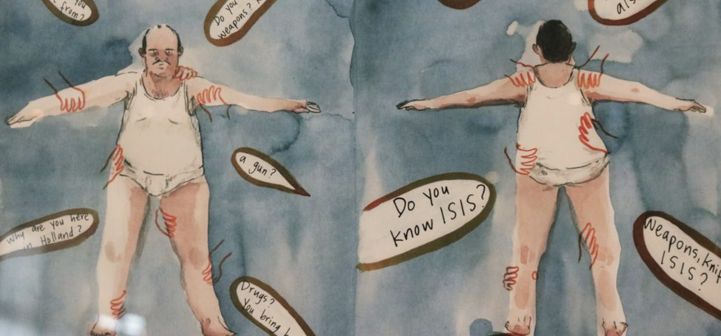
CIDTP & TORTURE
Intensity/severity of pain
Particular humiliation
Powerlessness
Purpose
Intent
Notes:
Illustration of searches of asylum seeker placed in detention in the Netherlands, possibly constitutive of CIDTP (© Alle Dagen Ui, B. Carrot).

Slide 10
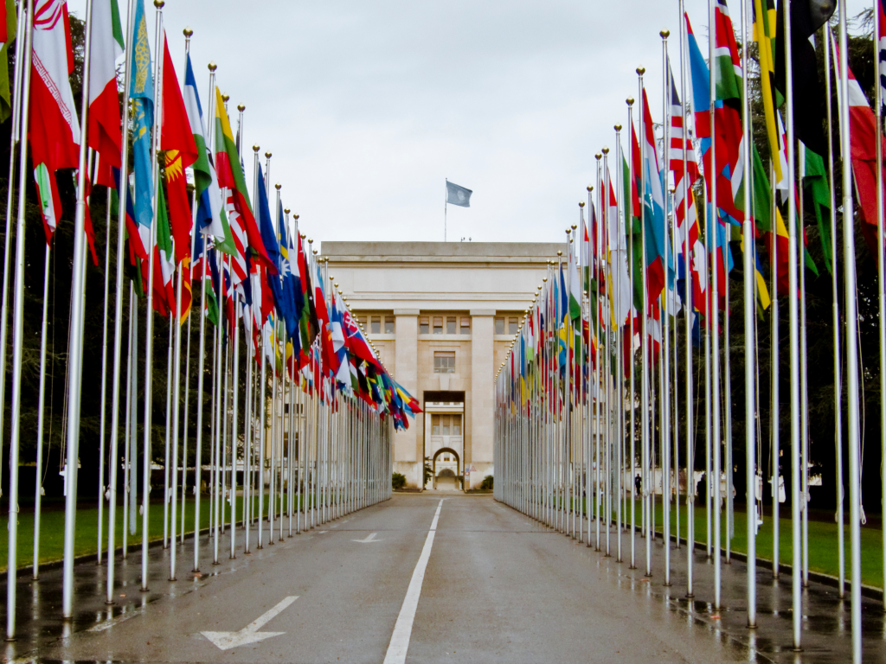
STATE OBLIGATIONS
Protect and Prevent
Prosecute and Punish
Provide redress
Notes:
Photo of the Palace of Nations (Palais des Nations), home of the United Nations Office in Geneva, Switzerland (© UN Photo).

Slide 11
PROTECT AND PREVENT
Measures
Training
Review
Safeguards
Exclusion
Guarantees

Slide 12
PROSECUTE & PUNISH
Offence
Punishable
Jurisdiction
Investigations
Allegation
Ex officio
Prosecute
Extradite

Slide 13
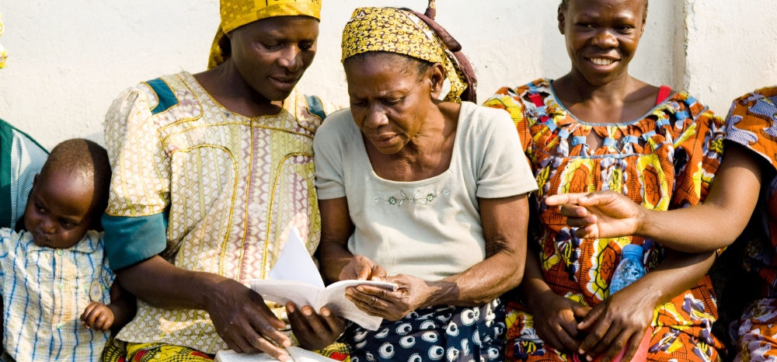
PROVIDE REDRESS
Compensation
Restitution
Victims of sexual violence in the DRC (© Aubrey Graham/IRIN/UN OCHA).
Rehabilitation
Satisfaction
Guarantees of non-repetition
© Aubrey Graham/IRIN
Notes:
Photo of victims of sexual violence in the DRC (© Aubrey Graham/IRIN/UN OCHA).

Slide 14
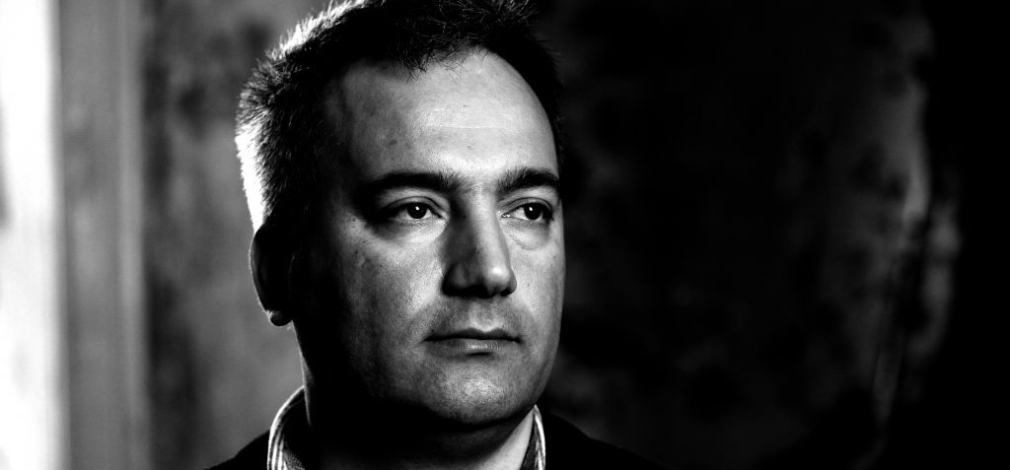
EXAMPLE: THE STORY OF NECATI ZONTUL
Notes:
Image of Necati Zontul (© REDRESS).
Case information here: https://redress.org/casework/necati-zontul-v-greece/
Watch a video about his case: https://youtu.be/WR-9S-33IZQ
Adapt case and link according to training needs.

Slide 15
BREAKOUT GROUPS
Group 1: [specify theme/case]
Group 2: [specify theme/case]
Notes:
This slide can be moved or copied to any point in the presentation to encourage brainstorming on a specific sub-theme.

Slide 16
redress.org

