Slide 1
NEGOTIATION
AND SETTLEMENT
FOR TORTURE

Slide 2
NOTIONS
Negotiation
Mediation
Inquiry
Conciliation
Arbitration

Slide 3
CONSIDERATIONS
State obligations (prevent, protect, prosecute, punish, redress)
Limited impact
Buy-out
No publicity
Implementation
Victim empowerment
Agency over outcome
Shorter timeframe

Slide 4
OTHER CONSIDERATIONS
Circumstances of victim (mental & physical state)
Risk of revictimisation
Sensitivity
Length
Objectives
Notes:
© Pawns, Ylanite Koppens/Pixabay.

Slide 5
POWER (IM)BALANCE
Tailored to protect client
Well-trained mediator
Outside pressures
Strategy
Fear & distrust
State v. victim
Perpetrator v. victim

Slide 6
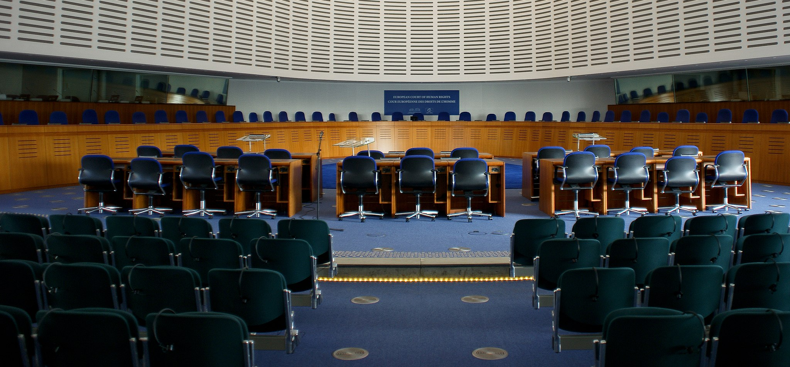
SETTLEMENTS IN REGIONAL & DOMESTIC SYSTEMS
IACtHR
AComHR
ECtHR
ACtHR
Notes:
Photo of the European Court of Human Rights (© Cherry X on Wikimedia Commons). per Wikimedia Commons Photo of the European Court of Human Rights (© Cherry X on Wikimedia Commons). Photo of the European Court of Human Rights (© Cherry X on Wikimedia Commons).

Slide 7
BREAKOUT GROUPS
Group 1: [specify theme/case]
Group 2: [specify theme/case]
Notes:
This slide can be moved or copied to any point in the presentation to encourage brainstorming on a specific sub-theme.

Slide 8
redress.org

