Slide 1
STRATEGIC
LITIGATION:
ADVOCACY
FRAMEWORK

Slide 2
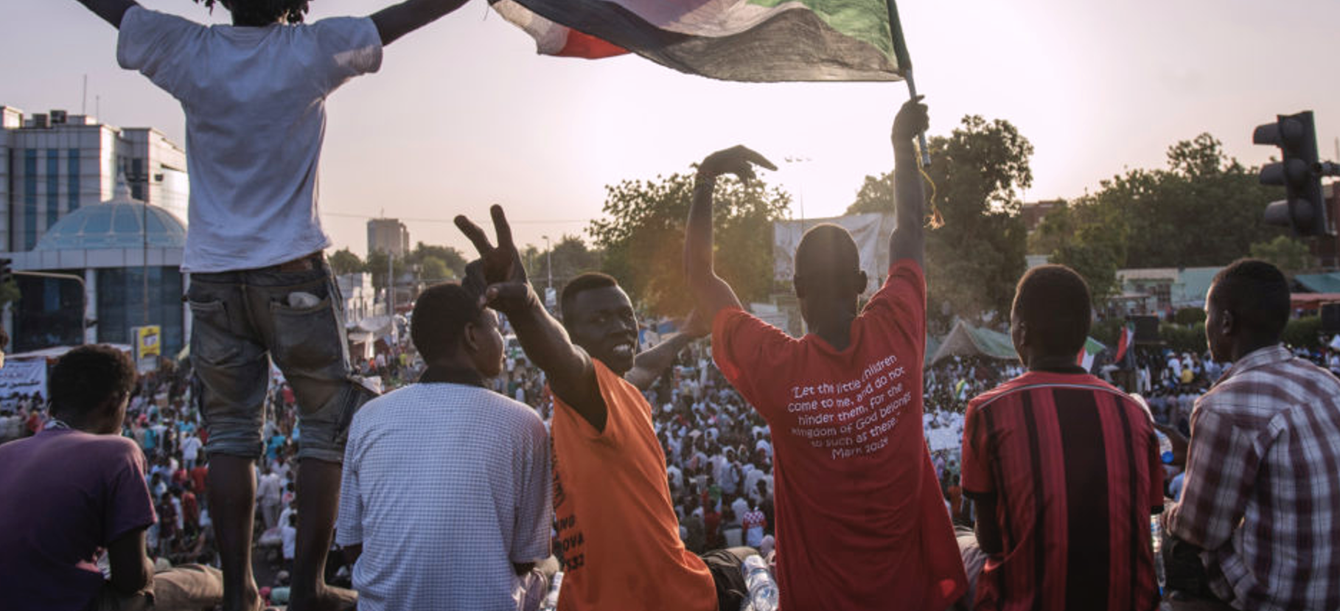
WHAT IS ADVOCACY?
Notes:
Photo of protesters waving national flags in Karthoum, Sudan’s capital, in April 2019 as the continuing citizen protests enter its fourth week since the fall of President Omar al-Bashir. The protesters were demanding that the transitional military council, that took power, be disbanded and for a new interim civilian ruling council be formed to enable the country to move towards a more democratic form of rule (© David Rose/Panos Pictures).

Slide 3
WHAT IS ADVOCACY?
Influence and persuade
Action by key actors
Outcomes for change

Slide 4
ADVOCACY STRATEGY
Outcomes
Delivery
Targets
Strategy
Planning
Message
Alliances
Messengers

Slide 5
ADVOCACY TARGETS
International
Diversify
National
Impact
Local
Regional
Notes:
Photo of the Palace of Nations (Palais des Nations), home of the United Nations Office in Geneva, Switzerland (© UN Photo).

Slide 6
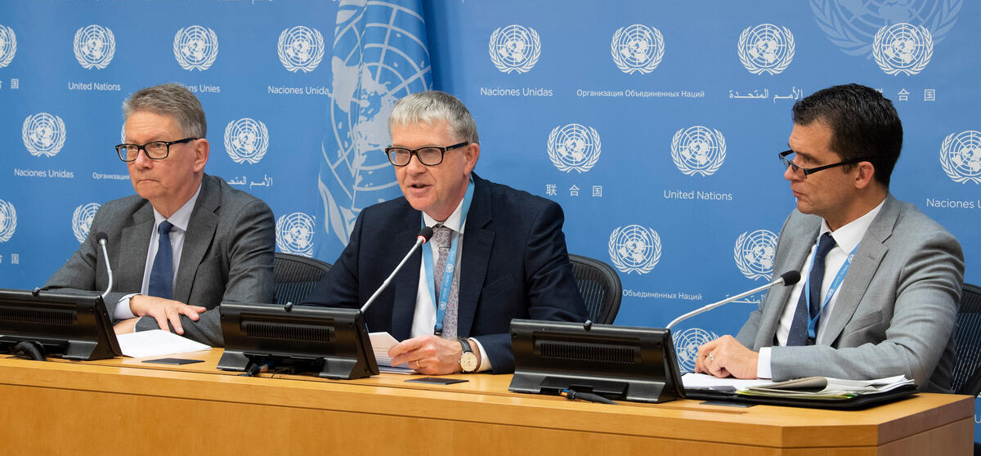
ADVOCACY TARGETS
Power
Influence
Compliance
Membership
Expertise
Notes:
Photo of a press briefing with Jens Modvig, Chair of Committee against Torture; Malcolm Evans, Chair of Subcommittee on Prevention of Torture; and Nils Melzer, Special Rapporteur on Torture (© UN Photo).

Slide 7
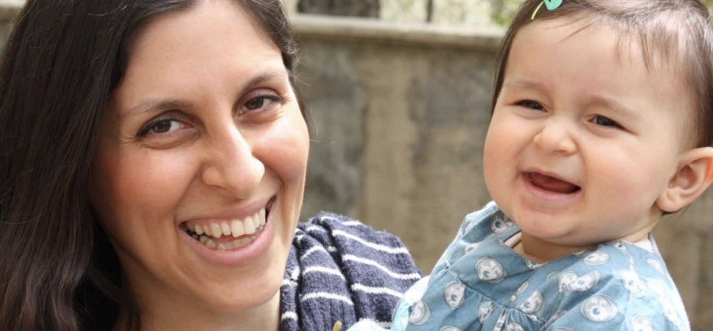
CRAFTING A MESSAGE
Notes:
Photo of Nazanin Zaghari-Ratcliffe and her daughter Gabriella (© Free Nazanin Campaign).

Slide 8
CRAFTING A MESSAGE
Humanising
Simple and clear
Context-sensitive
Tailored
© XXXXXXXXXXXXXX

Slide 9
ELEMENTS
Survivor-centred
Goals
Trust
Consent

Slide 10
BUILDING ALLIANCES
Alliances
Coordination
Sharing expertise
Message
Strength
Credibility
Outcome
Changing attitudes
Achieving goals

Slide 11
PLANNING AND DELIVERY
Planning
Flexibility
Persistence
Opportunities
Caption
Notes:
Photo © Nathan Dumlao on Unsplash.

Slide 12
CAMPAIGN FRAMEWORK
Media
Communication
Fact-finding
Litigation
Campaign
Reporting
Education
Notes:
Photos: Alamy; LFJL; Fabien Barral, Unsplash; Camilo Jimenez, Unsplash; Inaki del Olmo, Unplash; The Climate Reality Project, Unsplash; (© REDRESS).

Slide 13
CAMPAIGN FRAMEWORK
Litigation
Notes:
Photo of a hearing at the Inter-American Court of Human Rights (© REDRESS).
Domestic, regional, international courts
Can contribute to direct change for victims
Can contribute to legal, policy and institutional change
Can influence gradual social and political change

Slide 14
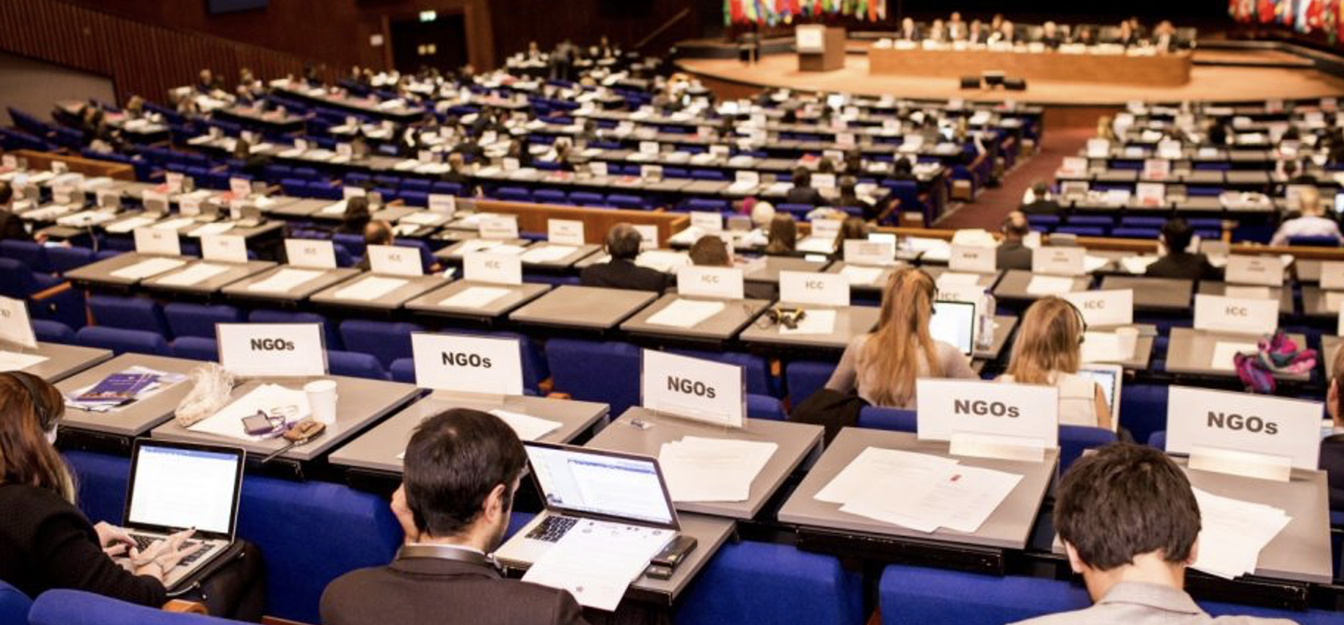
CAMPAIGN FRAMEWORK
Advocacy
Notes:
Photo: International Criminal Court’s Assembly of State Parties (© Mathias Berkovic/CICC)
Dialogue and discussions
One-on-one meetings
Committee membership and building relationships
Lobbying

Slide 15
CAMPAIGN FRAMEWORK
Research and communication
Notes:
Photo by Inaki del Olmo on Unsplash.
Position papers, briefing notes, factsheets, reports
Formal submissions to institutions e.g. shadow reports
Credibility
More difficult to ignore

Slide 16
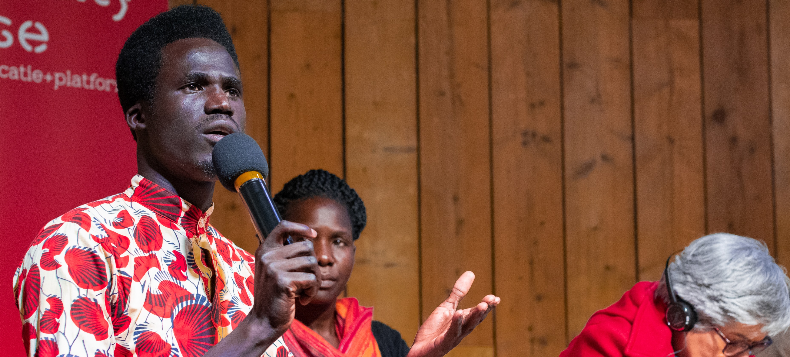
CAMPAIGN FRAMEWORK
Community organising
Notes:
Photo © ESA/REDRESS.
Engaging and empowering individuals and communities
Lived experience – effective and compelling advocates
Social mobilisation and public opinion - facilitate decision-making
Training and capacity-building

Slide 17
CAMPAIGN FRAMEWORK
Media
Notes:
Photo © Muhammadtaha Ibrahim Ma'Aji_Unsplash.
Pressure and visibility
Well-timed and sustained attention
Press releases, interviews, press conferences
Plan media strategy around stages of litigation – updates

Slide 18
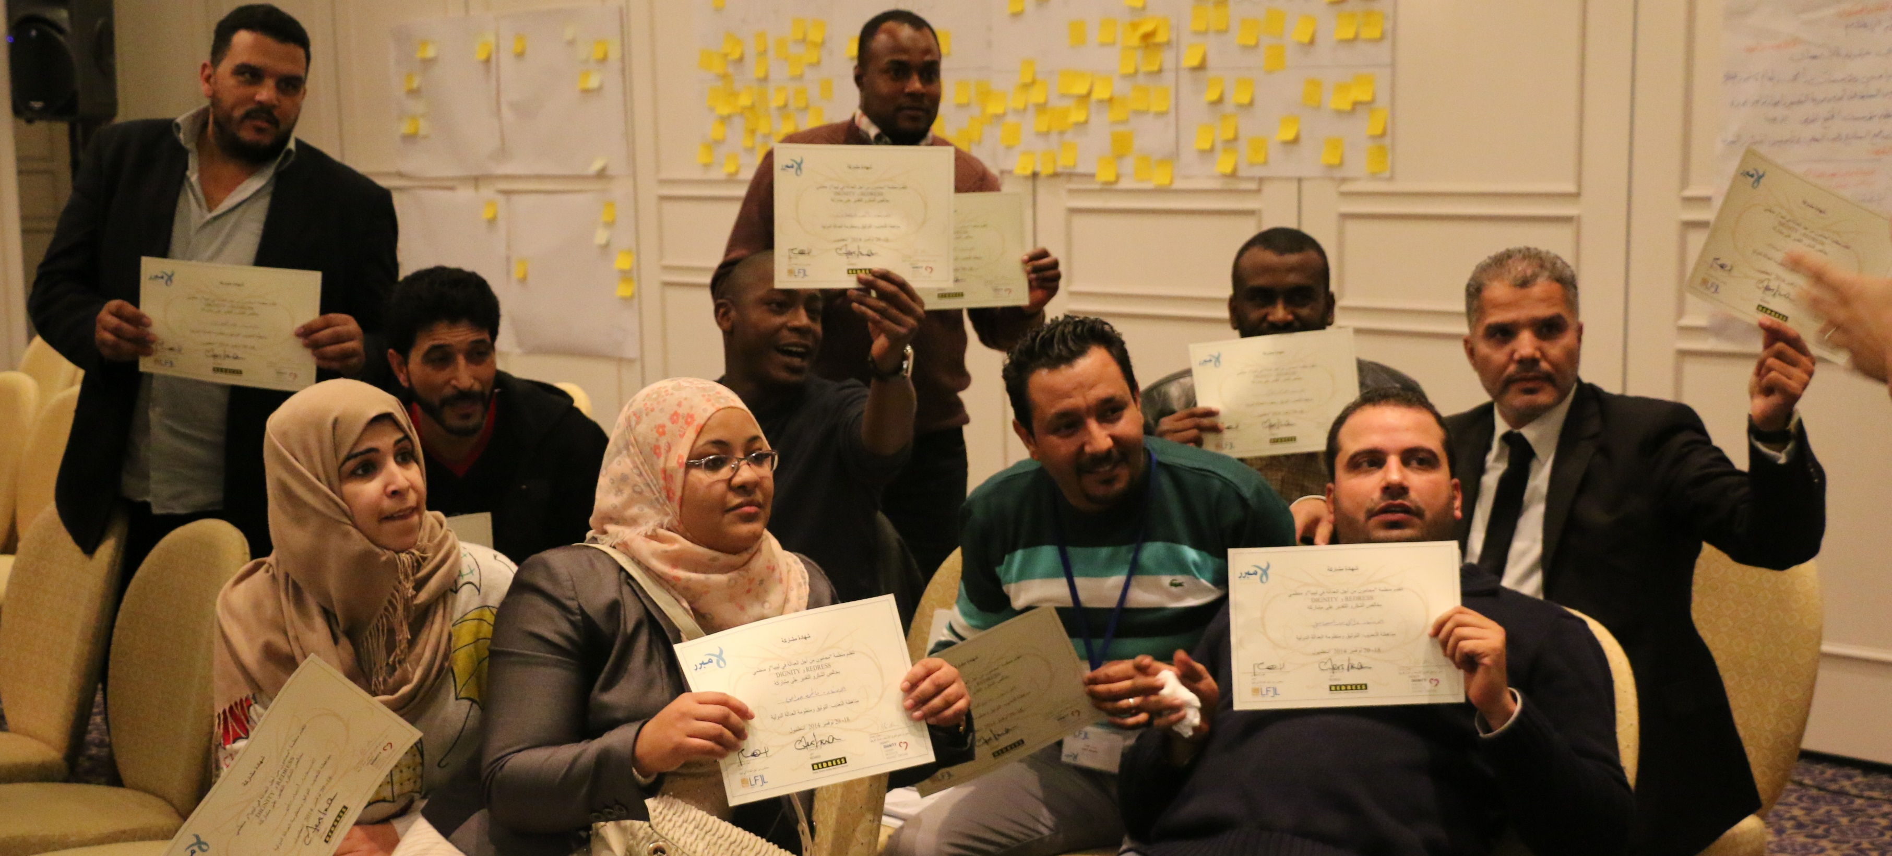
CAMPAIGN FRAMEWORK
Education and awareness
Notes:
Photo © LFJL.
Inform the public about the issue
Generate support
Workshops and conferences, print, internet

Slide 19
EXAMPLE: THE AZUL CASE IN PERU
Notes:
Photo of Azul Rojas Marín (© Promsex).
More information about the case: https://redress.org/casework/azul-rojas-marin-v-peru/
Video of the Azul case in English: https://youtu.be/qfx1DF1J2gI
Video of the Azul case in Spanish: https://youtu.be/NLmZC1MvYhY

Slide 20
BREAKOUT GROUPS
Group 1: [specify theme/case]
Group 2: [specify theme/case]
Notes:
This slide can be moved or copied to any point in the presentation to encourage brainstorming on a specific sub-theme.

Slide 21
redress.org

