Slide 1
FORUMS
UN TREATY BODIES
AND REGIONAL
MECHANISMS

Slide 2
INTRODUCTION
Exhaustion
Unavailability
Undue delays
National remedies
Regional and International Avenues

Slide 3
FACTORS
?
Admissibility criteria
Impact
Geographical location of the violation
Speed
?
?
Type of violation
Implementation
Treaty ratification status
Effectiveness

Slide 4
UN HUMAN RIGHTS SYSTEM: COMMITTEES
 | HRC | CAT | CED | CEDAW
Treaty | ICCPR | UNCAT | ICPPED | CEDAW
Expert members | 18 | 10 | 10 | 23
Specialty | Civil & political rights | Torture & CIDTP | Enforced Disappearances | Discrimination against women
Notes:
Photo of the Palace of Nations (Palais des Nations), home of the United Nations Office in Geneva, Switzerland (© UN Photo).

Slide 5
UN HUMAN RIGHTS SYSTEM: SPECIAL MANDATES
WGAD
WGEID
SR Torture
SR VAW
SR Truth
Notes:
Photo of a press briefing with Jens Modvig, Chair of Committee against Torture; Malcolm Evans, Chair of Subcommittee on Prevention of Torture; and Nils Melzer, Special Rapporteur on Torture (© UN Photo).

Slide 6
AFRICAN REGIONAL HUMAN RIGHTS MECHANISMS
 | AComHPR | ACtHPR | ECOWAS CJ
Treaty | African Charter | African Charter | UDHR, African Charter, ICCPR
Member states | 54 | 30 | ECOWAS States (15)
Location | Banjul, Gambia | Arusha, Tanzania | Abuja, Nigeria
Since | 1986 | 2006 | 1991
Notes:
Photo of a session of the African Commission on Human and Peoples’ Rights (© ACHPR).

Slide 7
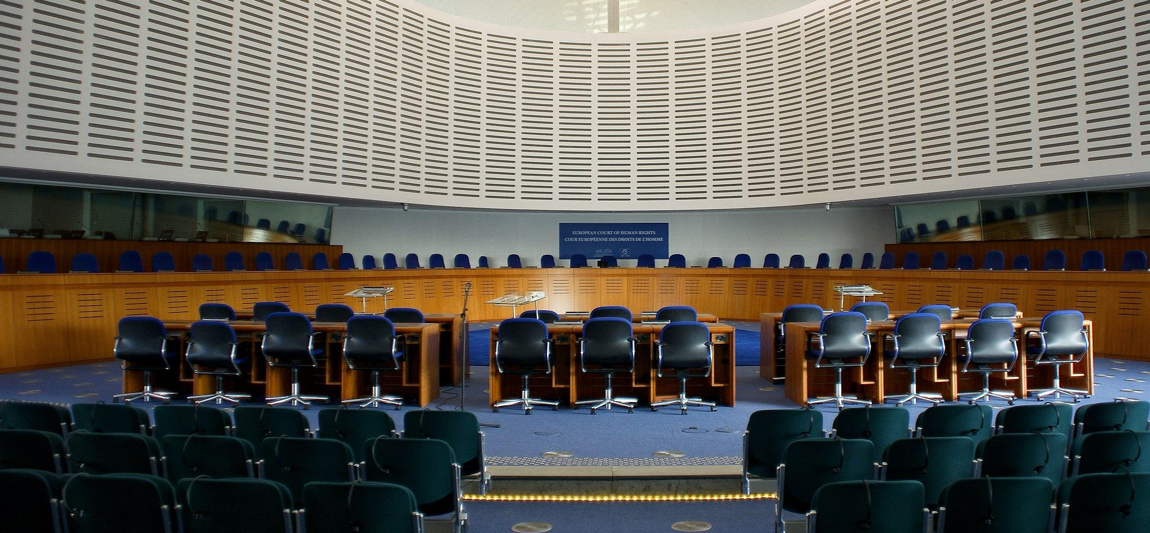
EUROPEAN REGIONAL HUMAN RIGHTS MECHANISM
Body | Petition | Treaty | Member States | Date | Location
ECtHR | Individuals, NGOs, States | ECHR | 47 | 1959 | Strasbourg, France
Notes:
Photo of the European Court of Human Rights (© Cherry X on Wikimedia Commons).

Slide 8
INTER-AMERICAN HUMAN RIGHTS MECHANISM
 | Petition | Treaty | Member States | Date | Location
IAComHR | Individuals, NGOs, States | American Declaration, ACHR, others | 35 | 1959 | Washington DC, US
IACtHR | IAComHR | ACHR | 20 | 1979 | San José, Costa Rica
Notes:
Photo of a hearing at the Inter-American Court of Human Rights (© REDRESS).

Slide 9
ADMISSIBILITY CRITERIA
Individuals, NGOs, States complaints
Time limits
State party to HR instrument
Not substantially same as other petition
Exhaustion of domestic remedies & exceptions
No appeals of domestic decisions

Slide 10
ADMISSIBILITY CRITERIA PER MECHANISM
 | Add. protocol/ declaration | Complaints from individuals | Complaints from NGOs | Complaints from states | Interim measures | Exhaustion of domestic remedies | Time limits
CAT | Y | Y | Y | Y | Y | Y | Y
HRC | Y | Y | Y | Y | Y | Y | Y
CEDAW | Y | Y | Y | Y | Y | Y | Y
CED | Y | Y | Y | Y | Y | Y | Y
UN Special mandates |  | Y | Y | Y | Y
AComHPR |  | Y | Y | Y | Y | Y | Y
ACtHPR | Y | Referred by the AComHPR | Referred by the AComHPR | Y | Y | Y | Y
ECOWAS CJ |  | Y | Y |  | Y
ECtHR |  | Y | Y | Y | Y | Y | Y
IAComHR |  | Y | Y | Y | Y | Y | Y
IACtHR | Y | Referred by AComHR | Referred by AComHR | Y | Y | Y | Y

Slide 11
BREAKOUT GROUPS
Group 1: [specify theme/case]
Group 2: [specify theme/case]
Notes:
This slide can be moved or copied to any point in the presentation to encourage brainstorming on a specific sub-theme.

Slide 12
redress.org

