Slide 1
TORTURE AND
CONDITIONS OF
DETENTION

Slide 2
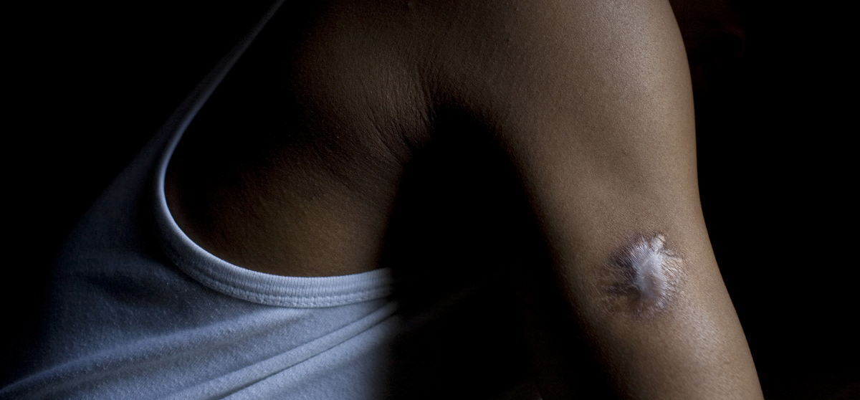
DEFINITION OF TORTURE
Conduct inflicting severe pain or suffering
Intent
Specific purpose
Involvement of a public official
Notes:
Photo of Boni, a businessman from Kinshasa, DRC, who was detained on suspicion of opposing the ruling government. While in detention he was forced into an electric chair, was repeatedly beaten and had a knife plunged through his armpit. His scars remain clearly visible (© Abbie Trayler-Smith/Panos Pictures).

Slide 3
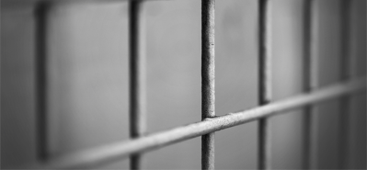
DETENTION
Vulnerable
Isolated
Police station
Prison
Immigration centre
Health centres
Childcare
Notes:
© Mitchell Haindfield, CC BY 2.0.

Slide 4
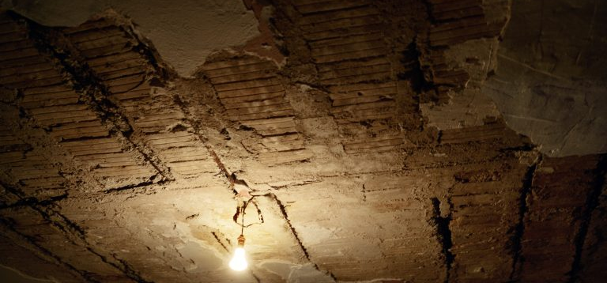
EXAMPLES
Excessive use of force
Violence
Abuse
Rape
Negligence
Sleep deprivation
Solitary confinement
Notes:
© Jim Goldberg/Magnum.

Slide 5
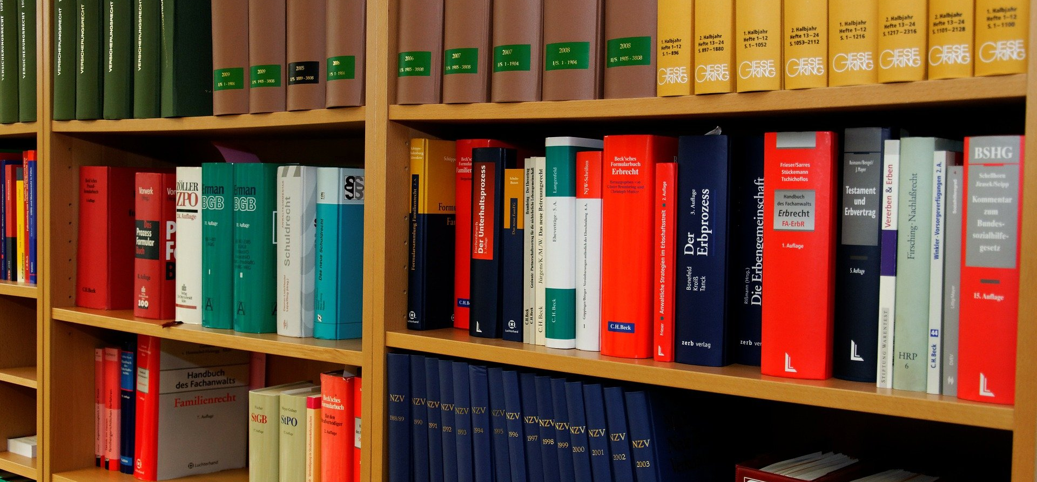
LEGAL STANDARDS
UN Basic Principles
Nelson Mandela Rules
Luanda Guidelines
Domestic codes
of conduct
Use of force necessary
and proportionate
© Jörg Möller/Pixabay

Slide 6
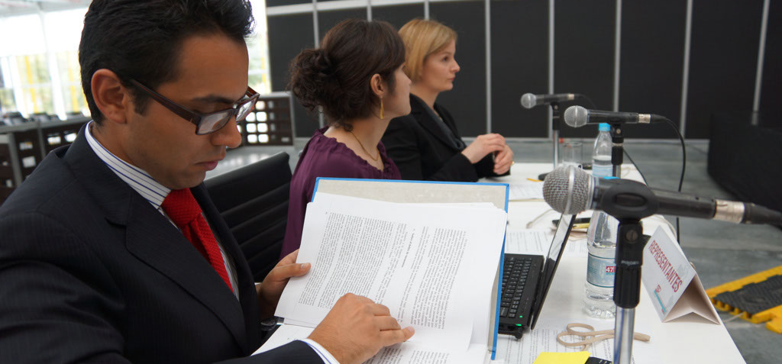
REPORT MECHANISMS
Inspections
Oversight
Consular protection
National Preventive
Mechanisms
Regional & international
Advocacy
Notes:
Photo of a hearing at the Inter-American Court of Human Rights (© REDRESS).

Slide 7
BREAKOUT GROUPS
Group 1: [specify theme/case]
Group 2: [specify theme/case]
Notes:
This slide can be moved or copied to any point in the presentation to encourage brainstorming on a specific sub-theme.

Slide 8
redress.org

